Slide 1

Statistical Fundamentals:
Using Microsoft Excel for Univariate and Bivariate Analysis
Alfred P. Rovai
Dependent t-Test
PowerPoint Prepared by
Alfred P. Rovai
Microsoft® Excel® Screen Prints Courtesy of Microsoft Corporation.

Slide 2
Dependent t-Test
The dependent t-test, also known as the paired-samples t-test and dependent samples t-test, is a parametric procedure that analyzes mean difference scores obtained from two dependent (related) samples.
Each case in one sample has a unique corresponding member in the other sample.
  Natural pairs: compare pairs that occur naturally, e.g., twins.
  Matched pairs: compare matched pairs, e.g., husbands and wives.
  Repeated measures: compare pairs from two observations of the same sample, e.g., pretest and posttest.
Excel data entry for the dependent t-test is accomplished by entering each observation, e.g., pretest and posttest, as separate columns in an Excel spreadsheet.

Slide 3
Dependent t-Test
One can compute the t-value using the following formula:
where the numerator is the difference in means of group 1 and group 2 and the denominator is the estimated standard error of the difference divided by the square root of the number of paired observations.

Slide 4
Dependent t-Test
Cohen’s d measures effect size and is often used to report effect size following a significant t-test. The formula for Cohen’s d for the dependent t-test is:
By convention, Cohen’s d values are interpreted as follows:
  Small effect size = .20
  Medium effect size = .50
  Large effect size = .80

Slide 5
Key Assumptions & Requirements
Random selection of samples to allow for generalization of results to a target population.
Variables. IV: a dichotomous categorical variable, e.g., observation (pretest,posttest). DV: an interval or ratio scale variable. The data are dependent.
Normality. The sampling distribution of the differences between paired scores is normally distributed. (The two related groups themselves do not need to be normally distributed.)
Sample size. The dependent t-test is robust to mild to moderate violations of normality assuming a sufficiently large sample size, e.g., N > 30. However, it may not be the most powerful test available for a given non-normal distribution.

Slide 6
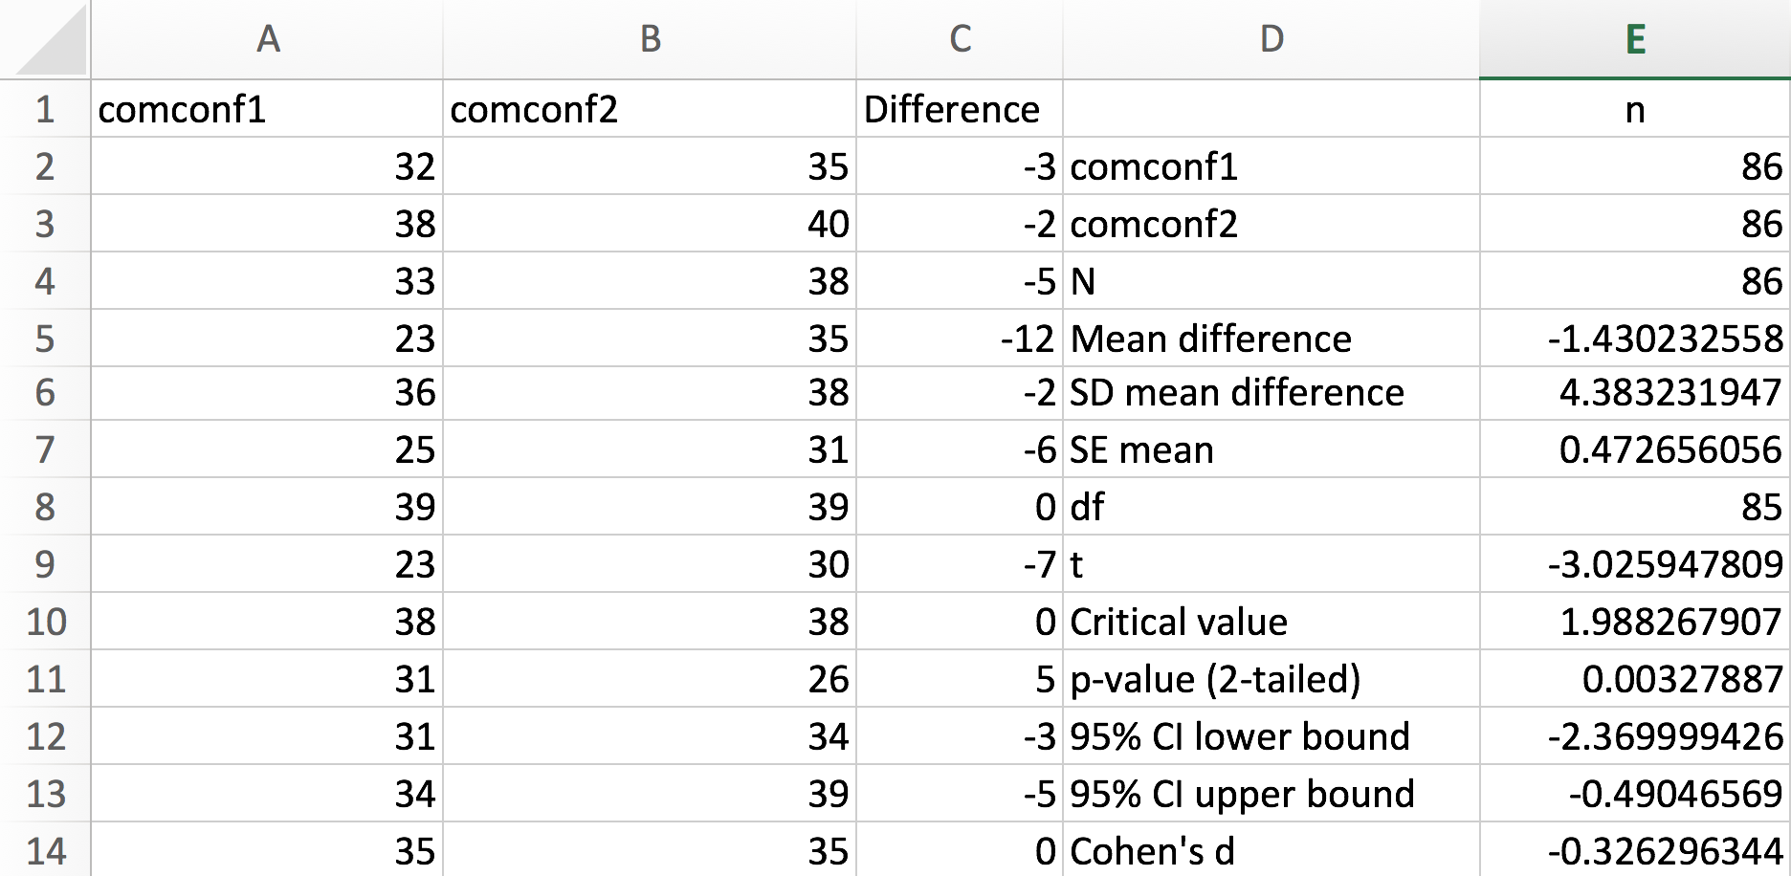
Conducting the Dependent t-Test
Open the dataset Computer Anxiety.xlsx. Click on the Dependent t-Test worksheet tab.
File available at http://www.watertreepress.com/stats
TASK
Respond to the following research question and null hypothesis:
Is there a difference between computer confidence pretest (comconf1) and computer confidence posttest (comconf2) among university students, μ1 − μ2 ≠ 0?
H₀: There is no difference between computer confidence pretest and computer confidence posttest among university students, μ1 − μ2 = 0.

Slide 7
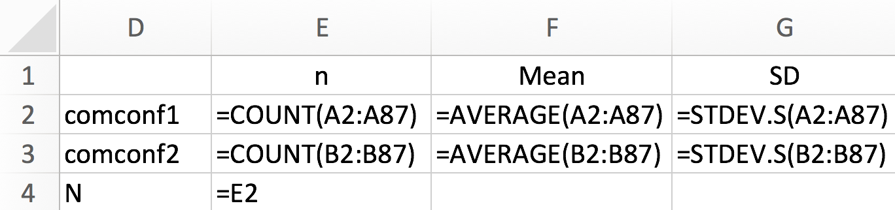
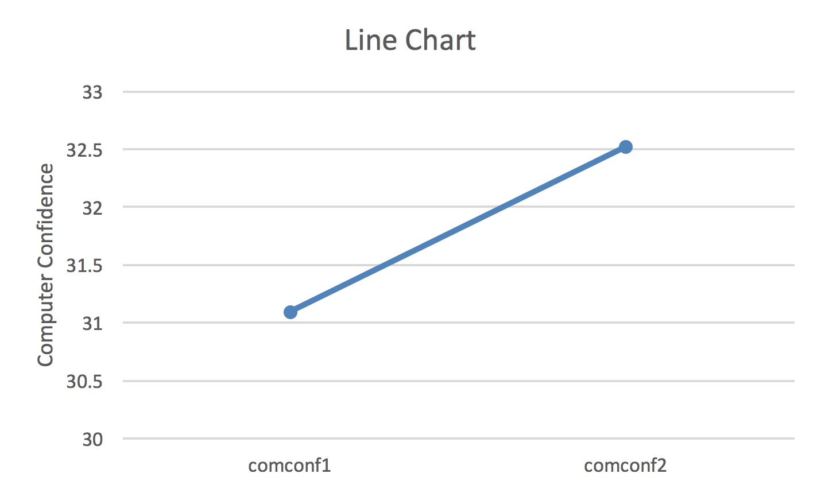
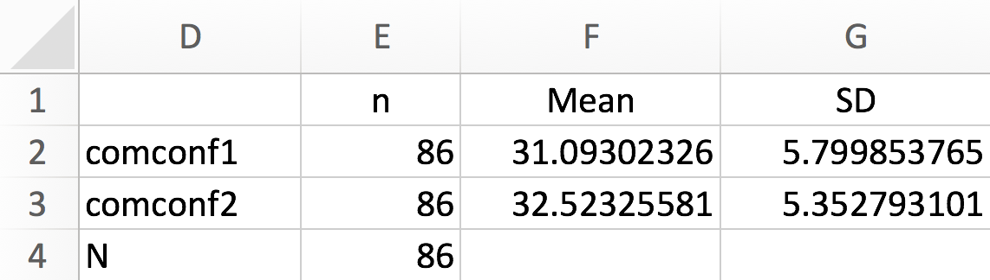
Descriptive Statistics
Enter the labels and formulas shown in cells D1:G4 in order to generate descriptive statistics.
Note that sample size (N) reprepresents the total number of cases in the sample. A common error is to double this value by adding each pretest observation to each posttest observation.
Results show that the mean computer confidence posttest (comconf2) score is higher than the mean computer confidence pretest (comconf1) score. Dependent t-test results will show whether or not this arithmetic difference is statistically significant.

Slide 8
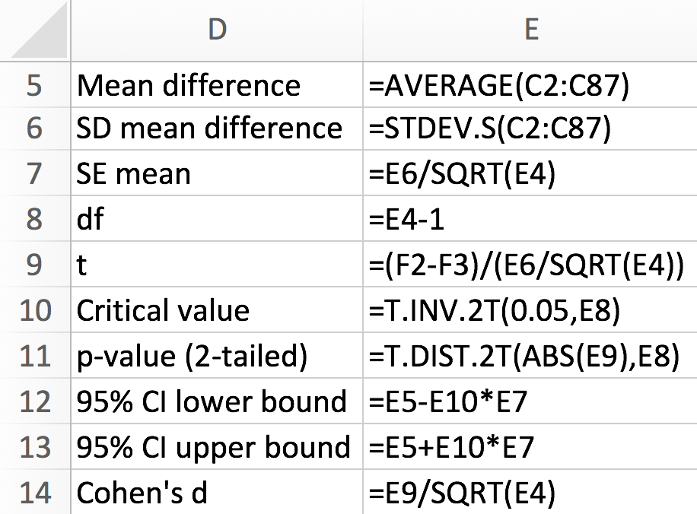
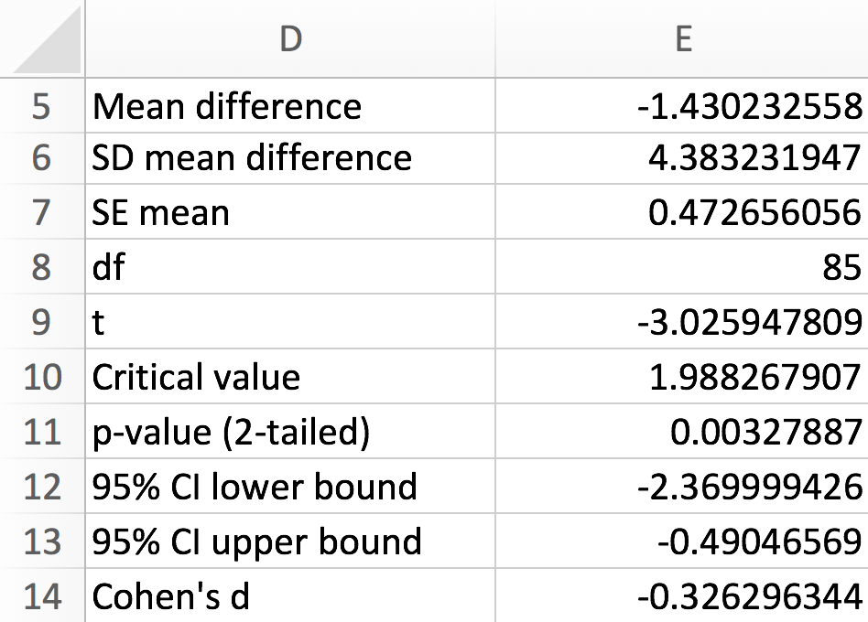
Dependent t-Test
Enter the formulas shown in cells D5:E14 in order to generate dependent t-test results. Note: Cells C2:C87 contain the differences between pretest and posttest scores.
Test results provide evidence that the difference between computer confidence pretest (M = 31.09, SD = 5.80) and computer confidence posttest (M =32.52, SD = 535) was statistically significant, t(85) = 3.03, p = .003 (2-tailed), d = .33.

Slide 9
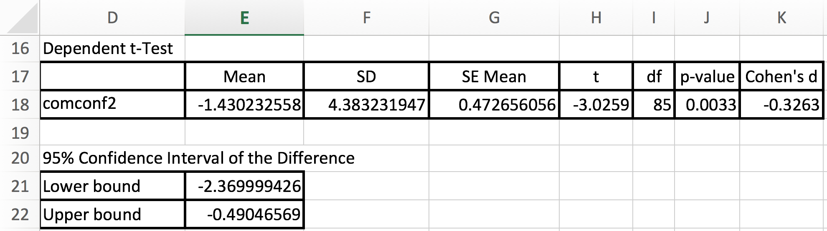
Test Results Summary
Test results provide evidence that there is sufficient evidence (p = 0.003) to reject the null hypothesis that there is no difference in mean computer confidence pretest and posttest scores.

Slide 10
Reporting Dependent t-Test Results
As a minimum, the following information should be reported in the results section of any report: null hypothesis that is being evaluated, descriptive statistics (e.g., M, SD, N), statistical test used (i.e., dependent t-test), results of evaluation of test assumptions, as appropriate, and test results. For example, one might report test results as follows. The formatting of the statistics in this example follows the guidelines provided in the Publication Manual of the American Psychological Association (APA).
Results
A dependent t-test was conducted to evaluate the null hypothesis that there is no difference between computer confidence pretest and computer confidence posttest among university students (N = 86). The results of the test provided evidence that computer confidence posttest (M = 32.52, SD = 5.35) was significantly higher than computer confidence pretest (M = 31.09, SD = 5.80), t(85) = 3.03, p = .003 (two-tailed), d = .33. Therefore, there was sufficient evidence to reject the null hypothesis. Effect size as measured by Cohen’s d was small.

Slide 11
Dependent t-Test
End of Presentation

